Slide 1


HOSPITAL OPERATIONAL MANAGEMENT ANALYSIS
ARJUN VANNATHAN KANDY – 041116775
VASANTH GNANASEELAN - 041112627

Slide 2
Table of contents
01
02
Introduction
Conceptual Diagram
03
04
Analysis/Insights
Business Strategies

Slide 3

Introduction
This analysis explores hospital operations, patient care, and resource utilization using SQL-based insights, enhancing decision-making through Power BI visualization.

Slide 4
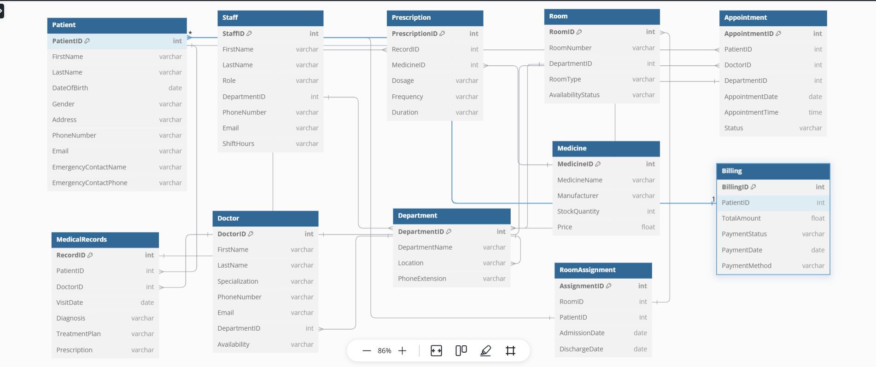
Conceptual Diagram

Slide 5
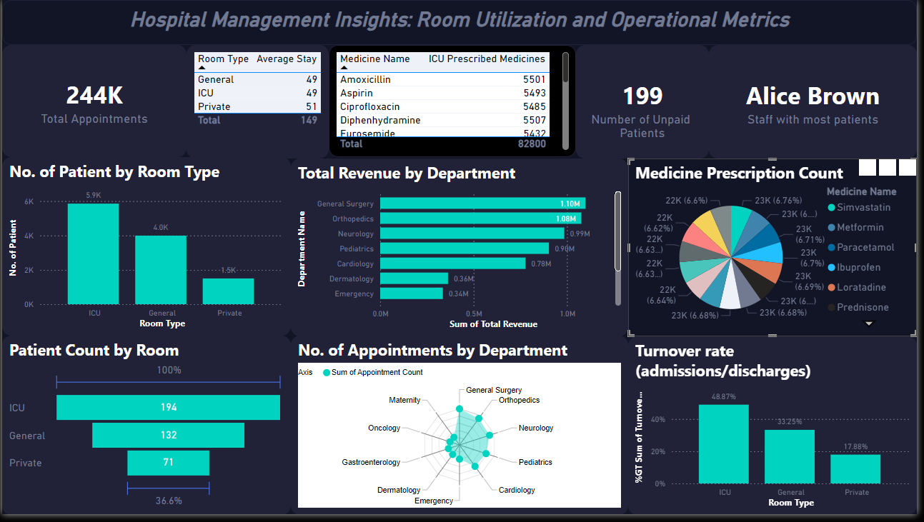
Dashboard

Slide 6
Analysis/Insights

Slide 7

Room Utilization and Turnover Rates
ICU has the highest patient count (48.87%) and turnover rate, indicating heavy utilization and demand. General rooms follow with 33.25%.
Private rooms have the lowest utilization (17.88%), suggesting potential underutilization or premium service preference.

Slide 8

Revenue Generation
General Surgery (1.10M) and Orthopedics (1.08M) contribute the highest revenue, followed by Neurology and Pediatrics (~0.99M each).
Dermatology and Emergency generate significantly lower revenue (~0.34M), reflecting fewer patients or lower service costs.

Slide 9

Medicine Prescription Patterns
Medicines like Amoxicillin, Aspirin, and Diphenhydramine are prescribed extensively in ICU settings.
The pie chart shows a balanced distribution of prescriptions, with commonly used medicines like Simvastatin and Metformin making up smaller shares.

Slide 10

A picture is worth
a thousand words

Slide 11

Key numbers
199
51
Unpaid bills indicate potential challenges in revenue collection or patient affordability issues.
Average length of stay for private rooms is 51 and 49 each for general and ICU
244k
Total Appointments

Slide 12

02
Business Strategies

Slide 13
Optimize Room Utilization
Increase marketing for private rooms or introduce promotional pricing to improve occupancy.
Evaluate ICU and general room allocation to avoid overburdening high-demand resources.

Slide 14
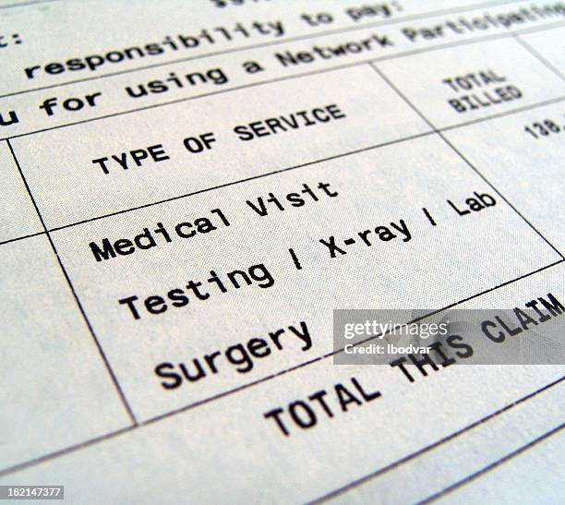
Enhance Billing Processes
Implement automated billing reminders and introduce flexible payment plans to reduce unpaid bills.
Monitor and optimize the financial process for better cash flow management.

Slide 15
Strengthen Revenue-Generating Departments
Allocate more resources and staff to General Surgery, Orthopedics, and Neurology to maximize their revenue potential.
Explore adding advanced services in low-revenue departments like Dermatology.

Slide 16
Medicine Management
Monitor frequently prescribed medicines and negotiate with suppliers for bulk discounts to lower costs.
Ensure stock availability for high-demand medications like Amoxicillin and Aspirin in ICU settings.

Slide 17
Staff Management
60%
80%
Review shift hours and workload for equitable distribution and retention.
Identify and replicate the practices of high-performing staffs like Alice Brown to enhance patient satisfaction and care quality.

Slide 18
Strategic Expansion
Based on high demand, consider expanding ICU and general room capacity or adding specialized units for popular departments.

Slide 19
Patient Experience and Retention
Conduct patient feedback surveys to improve underutilized services like private rooms and low-revenue departments.
Implement loyalty programs for patients to encourage return visits.

Slide 20
Thanks
Do you have any questions?

